Slide 1

Apache Kafka
Dima Ionut Daniel

Slide 2
Contents
What is Kafka?
History
Features
Use Cases
Architecture
Core
Best Practices
Bootstrap
Producers
Consumers
Topic Configuration
Schema Registry
Tools
Conclussion
Bibliography

Slide 3

What is Kafka?
Apache Kafka is an open-source message broker project developed by the Apache Software Foundation written in Scala.
Kafka has a modern cluster-centric design that offers strong durability and fault-tolerance guarantees.
Kafka is designed to allow a single cluster to serve as the central data backbone for a large organization.

Slide 4
What is Kafka? (cont.)
Apache Kafka is also:
distributed streaming platform
fault tolerant
horizontal scalability
can scale to 100s of brokers
can scale millions of messages per second
high performance, latency less than 10 ms.

Slide 5
History
Apache Kafka was originally developed by LinkedIn, and was subsequently open sourced in early 2011.
Graduation from the Apache Incubator occurred on 23 October 2012.
In November 2014, several engineers who built Kafka at LinkedIn created a new company named Confluent with a focus on Kafka.

Slide 6
Features
Persistent messaging: messages are persisted on disk as well as replicated within the cluster to prevent data loss.
High throughput: Kafka is designed to work on commodity hardware to handle hundreds of MB reads/writers per second.
Distributed: Kafka is cluster-centric design explicitly supports message partitioning over Kafka servers.
Multiple client support: easy integration with different platforms like Java, .NET, PHP, Ruby and Python.
Real time: messages produced by the producer threads should be immediately visible to consumer threads.

Slide 7
Use Cases
messaging system
activity tracking
gather metrics from many sources
application log gathering
stream processing (Kafka Streams API)
de-couple system dependencies
integration with BigData: Spark, Flink, Storm, Hadoop
microservices publisher/subscriber

Slide 8
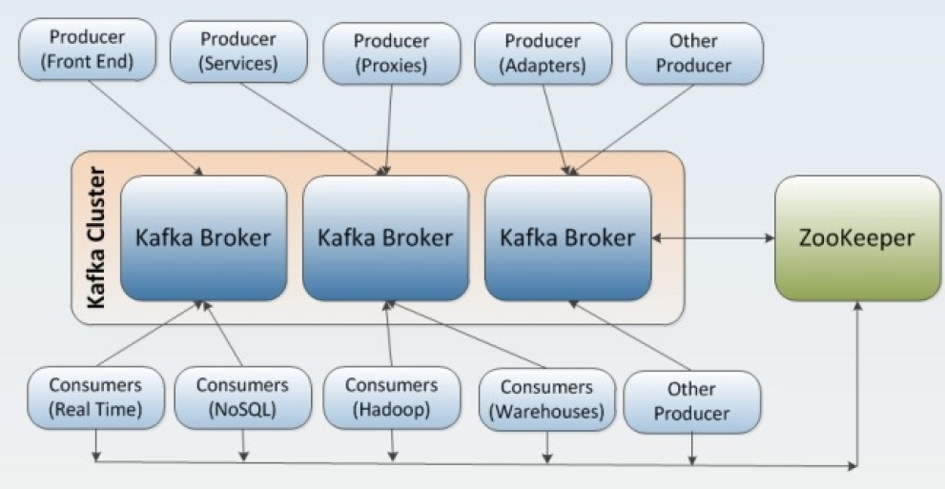
Architecture
Kafka supports also parallel data loading in the Hadoop systems.

Slide 9
Core
Message publishing is a mechanism for connecting various applications.
Kafka is a solution to real-time problems that provides seamless integration between information from producers and consumers.
Apache Kafka aims to unify offline and online processing by providing a mechanism for parallel load in Hadoop systems as well as the ability to partition real-time consumption over a cluster of machines.

Slide 10
Core (cont.)
Typical Kafka use cases:
Log aggregation: collecting log files from servers and put them in a central place (a file server or HDFS) for processing.
Stream processing: Kafka can be used for collecting data.
Commit logs: Kafka can be used to represent external commit logs for any large scale distributed system. Replicated logs over Kafka cluster help failed nodes to recover their states.
Click stream tracking: Kafka can capture use click stream data such as page views, searches, real-time publish-subscribe feeds.
Messaging: Message brokers are used for decoupling data processing from data producers. Kafka can replace many popular message brokers as it offers better throughput, built-in partitioning, replication and fault-tolerance.

Slide 11
Core (cont.)
Kafka is implemented Scala and uses build tool Gradle to build Kafka binaries.
Gradle is a build automation tool for Scala, Groovy and Java projects that requires Java 1.7 or higher.
With Kafka we can create multiple types of clusters:
single node, single broker cluster
single node, multiple broker clusters
multiple nodes, multiple broker clusters.

Slide 12
Core (cont.)
A Kafka cluster primarily has 5 main components:
Topic:
here messages are published by producers.
In Kafka, topics are partitioned and each partition is represented by ordered immutable sequence of messages.
each message in the partition is assigned a unique sequential ID called "offset".
Broker
consists of one or more servers.
topics are created within the context of broker processes.

Slide 13
Core (cont.)
Zookeeper:
coordinates the broker and the consumers.
allows distributed processes to coordinate with each other.
Producers:
publish data to the topics by choosing the appropriate partition within the topic.
Consumer:
processes the data that subscribe to topics

Slide 14
Core (cont.)
The sequence of messages is called a data stream.
Topics supports any kind of message format.
Topics are split into partitions.
Messages within each partition are ordered.
Each message gets an incremental id, called offset.
Topics are immutable: once data is written to a partition, it cannot be changed.

Slide 15
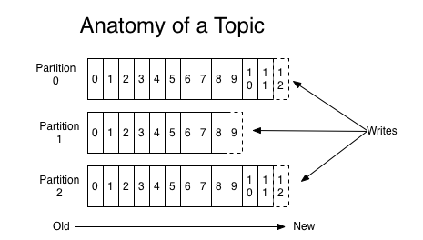
Core (cont.)
Data is kept only for a limited time, default is one week.
Offsets are not re-used even if previous messages have been deleted.
Order is guaranteed only withing a partition, not across partitions.
Data is assigned randomly to a partition unless a key is provided.

Slide 16
Core (cont.)
Producers:
write data to topics
know to which partition to write to
Producers can choose to send a key with the message(string, name, binary, etc)
If the key is null, data is sent round robin.

Slide 17
Core (cont.)
Kafka message structure:
key - binary, can be null
value - binary, can be null
compression type: none, gzip, snappy, lz4, zstd
headers, which are optional, key-value pairs
partition + offset
timestamp, set by the system or user

Slide 18
Core (cont.)
Kafka only accepts bytes as an input from producers and sends bytes out as output to consumers.
Kafka has common serializers for data types (JSON, int, float, avro, protobuf).
The Kafka partitioner is an entity which takes a record and determines to which partition to sent it to.
Key Hashing is the process of determining the mapping of a key to a partition.
The default Kafka partitioner is using the murmum2 algorithm.

Slide 19
Core (cont.)
Consumers:
read data from a topic, pull model
know which broker to read from
data is read in order, from low to high offset
De-serializer transforms bytes into object.
The serialization/deserialization type must not change during a topic lifecycle.

Slide 20
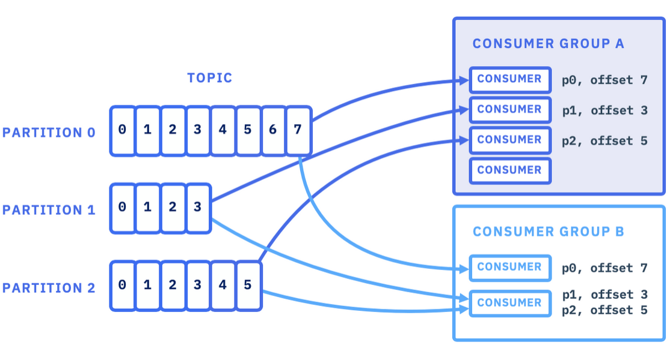
Core (cont.)
Consumer Groups:
All the consumers in an application read data as a consumer groups.
Each consumer within a group reads from exclusive partitions.
If we have more consumers than partitions, some consumers will be inactive.
We can have multiple consumer groups on the same topic.
To create distinct consumer groups, we need to use the property "group.id".

Slide 21
Core (cont.)
Consumer offsets:
Kafka stores the offsets at which a consumer group has been reading, named __consumer_offsets.
When a consumer from a group has processed data, it should periodically commit the offsets.
If the consumer crashes, it will be able to read back from where it left off thanks to the committed consumer offsets.
By default, java consumers will automatically commit offsets with mode - at least once.

Slide 22
Core (cont.)
There are 3 manually modes to commit:
at least once (preferred)
offsets are committed after the message is processed
if processing goes wrong, the message will be read again. This can result in duplicate processing of messages
at most once
offsets are committed as soon as messages are received
if processing goes wrong, the messages will be lost, as they won't be read again
exactly once
Kafka workflows: use the Transactional API
External System workflows: use an idempotent consumer

Slide 23
Core (cont.)
Brokers:
A Kafka cluster is composed of multiple brokers(servers)
Each broker is identified by an integer ID
Each broker container certain topic partitions
A good number to get started is 3 brokers.
Every broker is also called a "bootstrap server".
Each broker knows all brokers, topics and partitions (metadata).

Slide 24
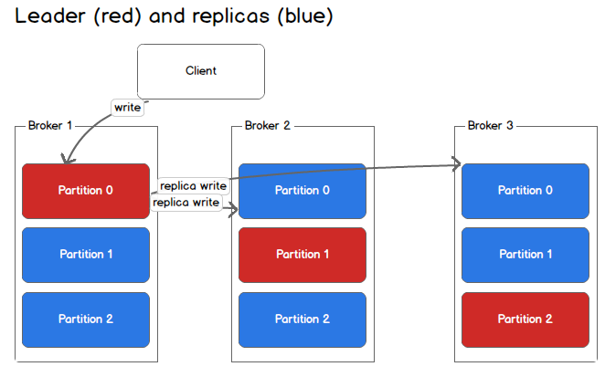
Core (cont.)
Topic replication factor:
Topics should have a replication factor > 1 .
If a broker is down, another broker can serve the data.
At any time, only one broker can be leader for a given partition.
Producers can only send data to the broker that is the leader of a partition.
Consumers by default will read data for a partition from the leader broker.
Each partition has one leader and multiple ISR(in-sync replica).

Slide 25
Core (cont.)
Kafka Consumer replica fetching was added in version 2.4
It's possible to configure consumers to read from the closest replica.
This may help improve latency, and last decrease network costs.

Slide 26
Core (cont.)
Producer acknowledgements (acks)
Producers can choose to receive acks of data writes.
acks=0 : producer won't wait for acks (possible data loss)
acks=1 : producer will wait for leader acks (limited data loss)
acks=all : leader + replicas acks (no data loss)

Slide 27
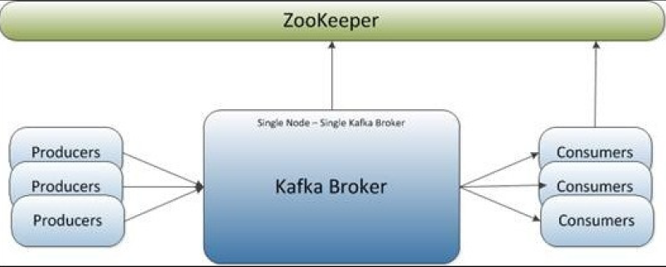
Core (cont.)
A simple setup for Kafka is single node, single Kafka Broker.

Slide 28
Core (cont.)
Kafka provides the default Zookeeper configuraiton file to launch a single local ZooKeeper instance.
bin/zookeeper-server-start.sh config/zookeeper.properties
In order to start the Kafka broker we need to execute:
bin/kafka-server-start.sh config/server.properties
The Zookeeper listens on port 2181 for incoming clients.
The Kafka Broker listens on port 9092.

Slide 29
Core (cont.)
Kafka provides a command line utility to create topics on the Kafka server.
bin/kafka-topics.sh --bootstrap-server localhost:9092 --create --replication-factor 1 --partitions 1 --topic kafkatopic
To obtain the list of topics on any Kafka server we use the command:
bin/kafka-topics.sh --bootstrap-server localhost:9092 --listThe decision about how a message is partitioned is taken by the producer and the broker stores the messages in the same order as they arrive.
The number of partitions can be configured for each topic within the Kafka broker.

Slide 30
Core (cont.)
To check the description for one topic use:
kafka-topics.bat --bootstrap-server localhost:9092 --describe --topic <TOPIC_NAME>
To describe all existent topics use:
kafka-topics.bat --bootstrap-server localhost:9092 –describe
To delete a topic, use:
kafka-topics.bat --bootstrap-server localhost:9092 --delete --topic <TOPIC_NAME>
This command won’t work on Windows without WSL2, and will make Kafka crash.

Slide 31
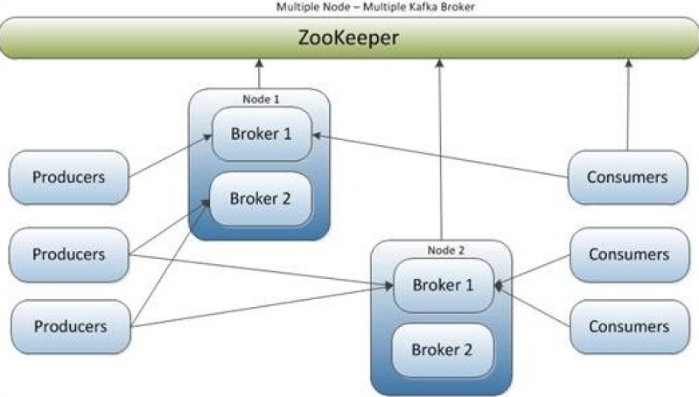
Core (cont.)
We can have multiple brokers configured on multiple nodes and the producers and consumers are connected in different combinations

Slide 32
Core (cont.)
Kafka broker property list
broker.id: non-negative integer ID.
log.dirs: directories in which the log data is stored.
zookeeper.connect: ZooKeeper connection string in hostname:port/chroot form like localhost:2181.
host.name: hostname of the broker.
num.partitions: default number of partitions per topic.
auto.create.topics.enable: enables auto-creation of the topic on the server.
default.replication.factor: default replication factory for automatically created topics.

Slide 33
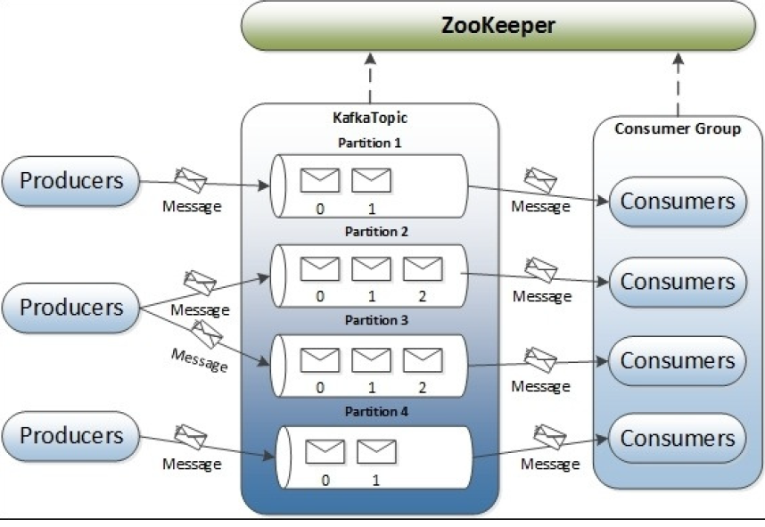
Core (cont.)
In Kafka topics, every partition is mapped to a logical log file that is represented as a set of segment files of equal sizes.

Slide 34
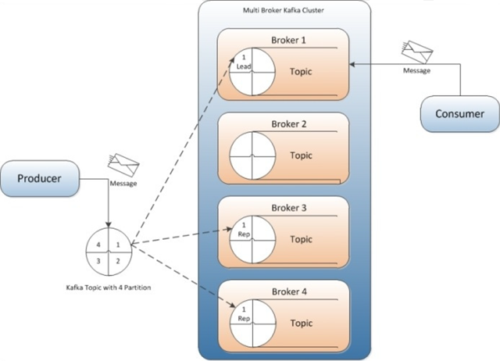
Core (cont.)
Kafka replication is a very important feature.

Slide 35
Core (cont.)
In replication each partition of a message has n replicas and can afford n-1 failures to guarantee message delivery.
Out of the n replicas, one replica acts as the lead replica for the rest of the replicas.
Kafka supports following replication modes: synchronous and asynchronous replication.

Slide 36
Best Practices
Each partition can handle a throughput of a few MB/s
More partitions implies:
better parallelism, better throughput
ability to run more consumers in a group to scale
ability to leverage more brokers if we have a large cluster
more elections to perform for Zookeeper, if we are using Zookeeper
more opened files on Kafka

Slide 37
Best Practices (cont.)
Replication factor should be at least 2, usually 3, maximum 4
Never set the value 1, in production
The higher the replication factor:
better durability of the system (N-1 brokers can fail)
better availability of the system (N- min.insync.replicas if producer acks=all)
more replication, higher latency if acks=all
more disk space on the system, 50% more if RF is 3 instead of 2

Slide 38
Best Practices (cont.)
Total number of partitions in the cluster:
Kafka with Zookeeper: max 200k partitions, Zookeeper scaling limit
It's recommended a maximum of 4000 partitions per broker
Kafka with KRaft: potentially scale to millions of partitions
If we need more partition in the cluster, we add brokers

Slide 39
Best Practices (cont.)
Topic naming conventions
It's better to enforce guidelines in the cluster to ease management
<message_type>.<dataset_name>.<data_name>.<data_format>
Message type: logging, queuing, tracking, etl, streaming, push
The dataset name is analogous to a database name in RDBMS systems
The data name field is analogous to a table name in RDBMS systems
The data format: .avro, .json, .text, .protobuf, .log, .csv

Slide 40

Bootstrap
Zookeper:
manages brokers
performs leader election for partitions
sends notifications in case of changes (new topic, broker down, broker up, delete topics, etc)
Kafka 2.x can not work without Zookeeper
Kafka 3.x can work without Zookeeper (KIP-500), using Kafka Raft instead
Kafka 4.x will not have Zookeeper anymore
Zookeeper by design operates with an odd number of servers (1,3,5,7)
Zookeeper has a leader and the rest are followers.
Zookeeper does NOT store consumer offsets with Kafka > v0.10

Slide 41
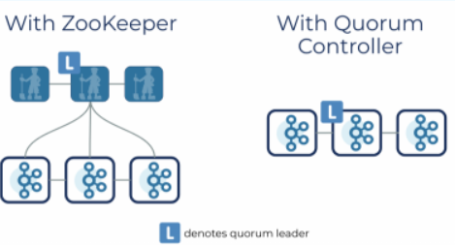
Bootstrap (cont.)
Apache Kafka Raft (KRaft)
started in 200, as Zookeeper had scaling issues when cluster > 100k partitions
is the consensus protocol that was introduced to remove Apache Kafka’s dependency on ZooKeeper for metadata management
use of a new quorum controller service in Kafka
can scale millions of partitions
single security model for whole system
single process to start Kafka
faster controller shutdown and recovery time

Slide 42
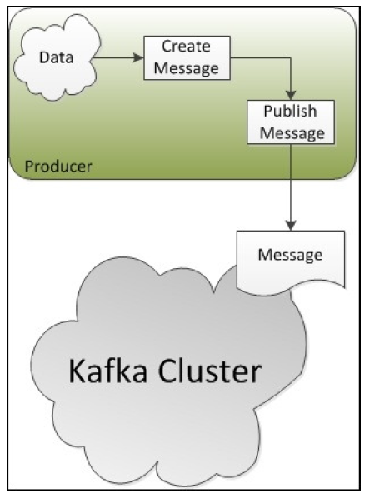
Producers
Producers are applications that create messages and publish them to the Kafka broker.

Slide 43
Producers (cont.)
The command utility kafka-console-producer.bat is used to created Kafka producers and produce data.
kafka-console-producer.bat --bootstrap-server localhost:9092 --topic atopic
kafka-console-producer.bat --bootstrap-server localhost:9092 --topic atopic --producer-property acks=all
kafka-console-producer.bat --bootstrap-server localhost:9092 --topic atopic --property key=value
kafka-console-producer.bat --bootstrap-server localhost:9092 --topic atopic --property parse.key=true --property key.separator=:
If we try to write data to an inexistent topic, the topic will be created with 1 partition.

Slide 44
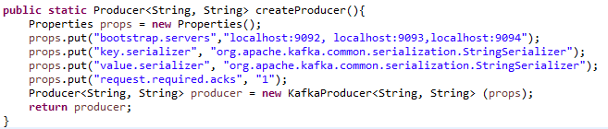
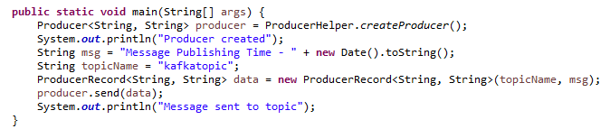
Producers (cont.)
Bellow is a sample of using Producers in Kafka.

Slide 45
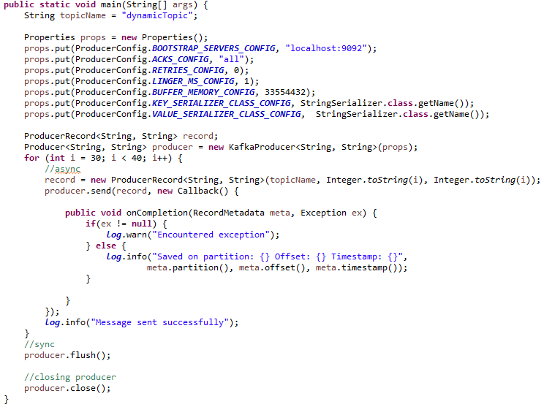
Producers (cont.)

Slide 46
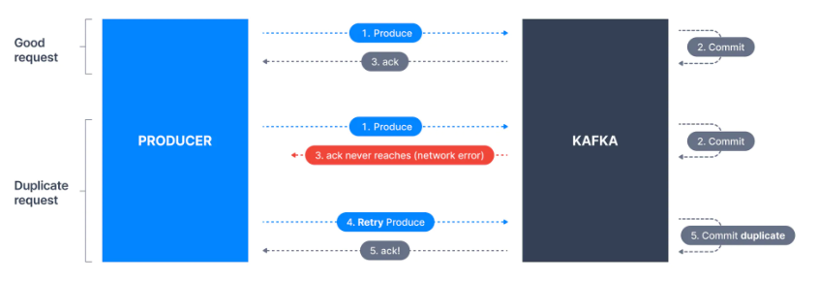
Producers (cont.)
Idempotent producers are great to guarantee a stable and safe pipeline.
They are the default since Kafka 3.0.
To enable this feature, set the "enable.idempotence" to true, in producer properties.

Slide 47
Producers (cont.)
By default, Kafka producers try to send records as soon as possible
it will have up to max.in.flight.requests.per.connection=5, meaning up to 5 message batches being in flight at most
after this, if more messages must be sent while other are in flight, kafka is smart and will start batching them before the next batch send
This smart batching help increase throughput while maintaining very low latency
added benefit: batches have higher compression ratio so better efficiency
2 settings influence the batching mechanism
linger.ms: (default 0), how long to wait until we send a batch.
batch.size: if a batch is filled before linger.ms, increase the batch size

Slide 48
Producers (cont.)
To have high throughput producer:
use snappy message compression in the producer
snappy is very helpful if the messages are text based: documents, JSON, etc.
snappy has a good balance of CPU/compression ratio
increase batch.size to 32KB and produce a small delay though linger.ms (20 ms)

Slide 49
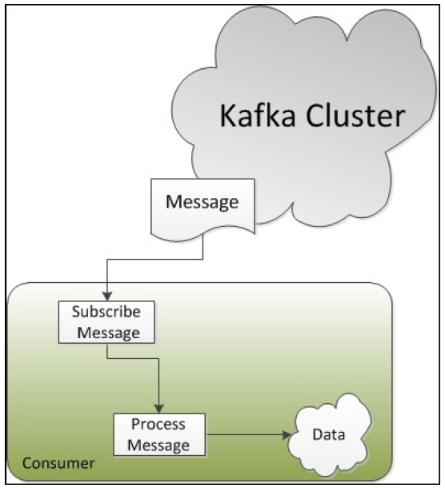
Consumers
Consumers are applications that consume the messages published by producers.

Slide 50
Consumers (cont.)
Kafka provides 2 types of API for Java consumers: high-level and low-level.
The high-level consumer API is used when only data is needed and the handling of message offsets it not required.
The API hides broker details from the consumers and allows effortless communication with Kafka cluster.
The low-level consumer API is stateless and provides fine grained control over the communication between Kafka broker and the consumer.
It allows consumers to set the message offset with every request raised to the broker and maintains the metadata at the consumer's end.

Slide 51
Consumers (cont.)
To use consumers we can use the command utility kafka-console-consumer.bat :
We can consume from the tail of the topic or from the beginning of the topic.
kafka-console-consumer.bat --bootstrap-server localhost:9092 --topic atopic
kafka-console-consumer.bat --bootstrap-server localhost:9092 --topic atopic --from-beginning
Custom command to display extra info:
kafka-console-consumer.bat --bootstrap-server localhost:9092 --topic atopic --formatter kafka.tools.DefaultMessageFormatter --property print.timestamp=true --property print.key=true --property print.value=true --from-beginning

Slide 52
Consumers (cont.)
To use consumer group we need to add the --group parameter:
kafka-console-consumer.bat --bootstrap-server localhost:9092 --topic atopic --group consumer-group
Consumers from the group will read data from different partitions.
Consumer groups utility: kafka-consumer-groups.bat:
kafka-consumer-groups.bat --bootstrap-server localhost:9092 --list
kafka-consumer-groups.bat --bootstrap-server localhost:9092 --describe --group <GROUP_NAME>

Slide 53
Consumers (cont.)
kafka-consumer-groups.bat --bootstrap-server localhost:9092 --describe --group consumer_group1
GROUP TOPIC PARTITION CURRENT-OFFSET LOG-END-OFFSET LAG CONSUMER-ID HOST CLIENT-ID
consumer_group1 atopic 0 7 7 0 console-consumer-3d0f0f30-5029-4afb-9252-d7cb83be905e /10.7.1.157 console-consumer
consumer_group1 atopic 1 4 4 0 console-consumer-3d0f0f30-5029-4afb-9252-d7cb83be905e /10.7.1.157 console-consumer
consumer_group1 atopic 2 6 6 0 console-consumer-a8bd28be-bf29-4f5c-980d-e27c334b179a /10.7.1.157 console-consumer

Slide 54
Consumers (cont.)
We can reset offsets using the –reset-offsets parameter.
kafka-consumer-groups.bat --bootstrap-server localhost:9092 --group consumer_group1 --reset-offsets --to-earliest --execute --all-topics
GROUP TOPIC PARTITION NEW-OFFSET
consumer_group1 atopic 1 0
consumer_group1 atopic 0 0
consumer_group1 atopic 2 0
kafka-consumer-groups.bat --bootstrap-server localhost:9092 --describe --group consumer_group1
GROUP TOPIC PARTITION CURRENT-OFFSET LOG-END-OFFSET LAG CONSUMER-ID HOST CLIENT-ID
consumer_group1 atopic 0 0 7 7 - - -
consumer_group1 atopic 1 0 4 4 - - -
consumer_group1 atopic 2 0 6 6 - - -

Slide 55
Consumers (cont.)
Offsets shifted backwards by 2
kafka-consumer-groups.bat --bootstrap-server localhost:9092 --group consumer_group1 --reset-offsets --shift-by -2 --execute --all-topics
Offsets shifted forwards by 2
kafka-consumer-groups.bat --bootstrap-server localhost:9092 --group consumer_group1 --reset-offsets --shift-by 2 --execute --all-topics

Slide 56
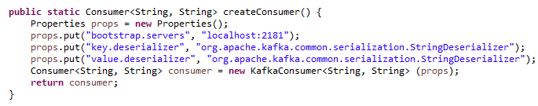
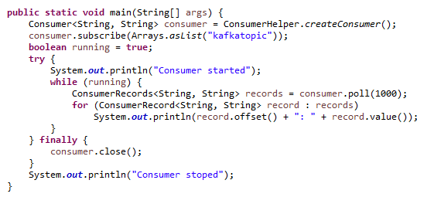
Consumers (cont.)
To begin consumption we need to subscribe to the topic.

Slide 57
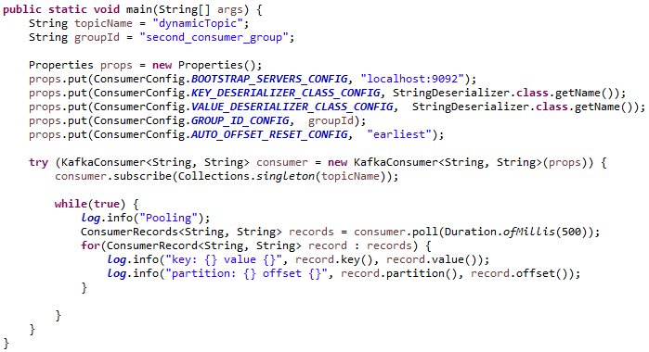
Consumers (cont.)

Slide 58
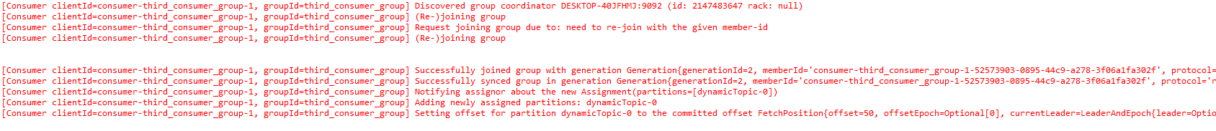
Consumers (cont.)
If we run in parallel the consumer, we can see in the logs that the second consumer is joining the group.
The first consumer receives the request for another consumer to join:
The second consumer has the following logs:

Slide 59
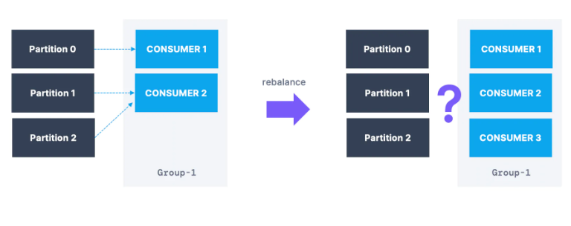
Consumers (cont.)
Partition rebalance on consumers
Moving partitions between consumers is called rebalance.
Reassignment of partitions happen when a consumer leaves or joins a group.
Also the administrator can add new partitions into a topic.

Slide 60
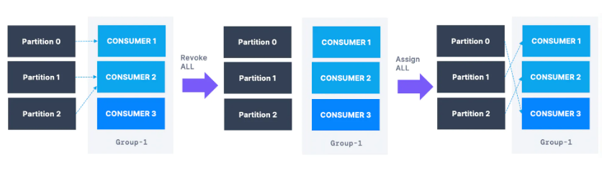
Consumers (cont.)
Eager rebalance
all consumers stop, give up their memberships of partitions
they rejoin the consumer group and get a new partition assignment
during a short period of time, the entire consumer group stops processing
consumers don't necessary "get back" the same partitions as they used to

Slide 61
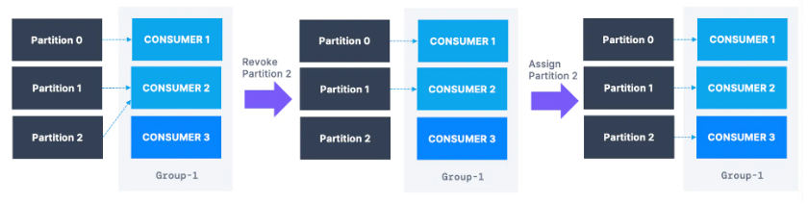
Consumers (cont.)
Cooperative rebalance (incremental rebalance)
re-assigns a small subset of the partitions from one consumer to another
other consumers that don't have re-assigned partitions can still process uninterrupted
can go through several iterations to find a "stable" assignment
avoids the stopping of the events where all consumers stop processing data

Slide 62
Consumers (cont.)
Kafka Consumer has a property called: partition.assignment.strategy
RangeAssignor: assign partition on a per-topic basis
RoundRobin: assign partitions across all topics in round-robin fashion, optimal balance
StickyAssignor: balanced like RoundRobin, and then minimizes partition movement when consumer join/leave the group in order to minimize movements
CooperativeStickAssignor: rebalance strategy is identical to StickyAssignor, but supports cooperative rebalances and therefore consumers can keep on consuming from the topic.

Slide 63
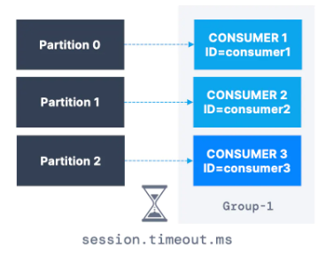
Consumers (cont.)
Static group management
by default, when a consumer leaves a group, its partitions are revoked and re-assigned
if it joins back, it will have a new "member ID" and new partitions assigned
if you specify "group.instance.id" it makes the consumer a static member
upon leaving, the consumer has up to "session.timeout.ms" to join back its partitions, without triggering a rebalance

Slide 64
Consumers (cont.)
heartbeat.interval.ms:
how often to send heartbeats
usually set to 1/3 of session.timeout.ms
default 3 seconds
session.timeout.ms
heartbeats are sent periodically to the broker
if not heartbeat is sent during that period, the consumer is considered dead
set even lower to faster consumer rebalances
default 43 seconds Kafka 3.0+, before was 10 seconds

Slide 65
Consumers (cont.)
max.poll.interval
maximum amount of time between 2 poll() calls before declaring the consumer dead
this is relevant to big data frameworks like Spark
default is 5 minutes
This mechanism is used to detect a data processing issue with the consumer
max.poll.records
controls how many records to receive per poll request
increase if we have very small messages and we have lot of RAM
good to monitor how many records are polled per request
lower if it takes to much time to process records
default is 500

Slide 66
Consumers (cont.)
fetch.min.bytes
controls how much data we want to pull at least on each request
helps improving throughput and decreasing request number
at the cost of latency
default is 1
fetch.max.waits.ms
the maximum amount of time the broker will block before answering the fetch request if there isn't sufficient data to immediately satisfy the requirement given by “fetch.min.bytes”
default is 500

Slide 67
Consumers (cont.)
max.partition.fetch.bytes
the maximum amount of data per partition the server will return
if we read from many partitions, we'll need a lot of memory (RAM)
default is 1MB
fetch.max.bytes
maximum data returned for each fetch request
if we have available memory, we can increase “fetch.max.bytes” to allow the consumer to read more data in each request
default is 55MB

Slide 68
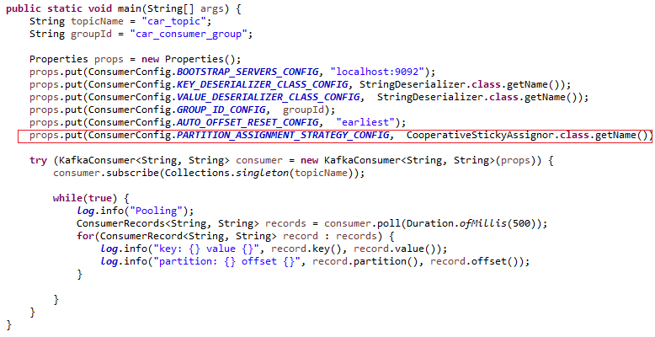
Consumers (cont.)
We can specify the assignment strategy on a consumer group.

Slide 69
Consumers (cont.)
First consumer:
Second consumer:

Slide 70
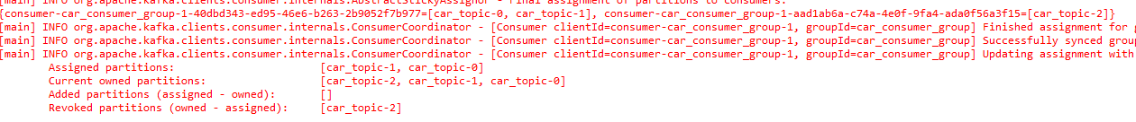
Consumers (cont.)
First consumer after a few second when second consumer joined:
Second consumer:

Slide 71
Consumers (cont.)
After the close the second consumer, we need to wait the “session.timeout.ms” time and we’ll see in the logs:

Slide 72
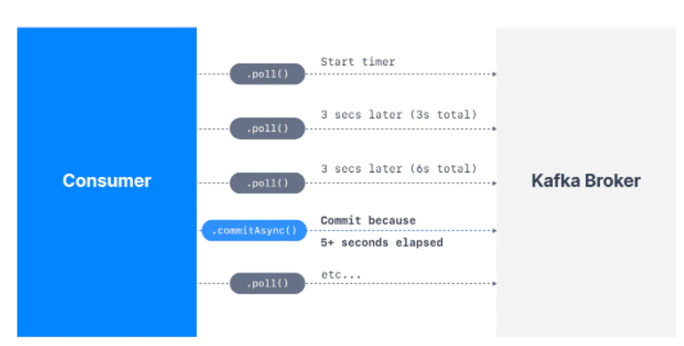
Consumers (cont.)
In the Java Consumer API, offsets are regularly committed
Offsets are committed when we call poll() and auto.commit.interval.ms has elapsed.
We need to make sure that all messages are successfully processed before we call poll() method again.

Slide 73
Topic Configuration
Broker have default for all the topic configuration parameters
These parameters impact performance and topic behavior
Some topics may need different values than the defaults:
replication factor
number of partitions
message size
compression level
log cleanup policy
min insync replicas
others configurations

Slide 74
Topic Configuration (cont.)
We can update topic configurations using kafka-configs utility
kafka-configs --bootstrap-server localhost:9092 --entity-type topics --entity-name configured-topic --alter --add-config min.insync.replicas=2
kafka-configs --bootstrap-server localhost:9092 --entity-type topics --entity-name configured-topic --describe

Slide 75
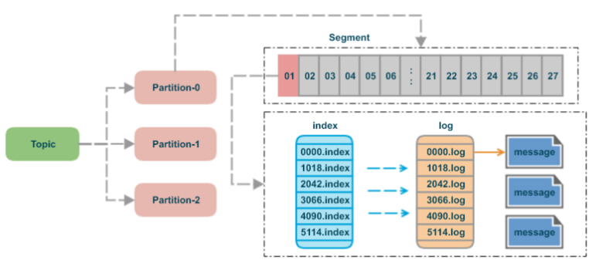
Topic Configuration (cont.)
The topics are made of partitions
Partitions are made of segments (files)
Only one segment is ACTIVE, the one data is being written to
There are 2 segment settings:
log.segment.bytes: the max size of a single segment in bytes (default 1GB)
log.segment.ms: the time Kafka will wait before committing the segment if not full (1 week)

Slide 76
Topic Configuration (cont.)
Segments come with 2 indexes (files):
an offset to position index: helps Kafka find where to read from to find a message
a timestamp to offset index: helps Kafka find messages with a specific timestamp
a smaller log.segment.bytes means:
more segments per partitions
log compaction happens more often
Kafka must keep more files opened, it could lead to "Too many open files"

Slide 77
Topic Configuration (cont.)
Log cleanup policies
Many Kafka clusters make data expire based on a policy
log.cleanup.policy=delete
Kafka default for all user topics
Deletes based on the age of the data
Default is a week
log.cleanup.policy=compact
Kafka default for topic __consumer_offsets
Deletes based on keys of the messages
Will delete old duplicate keys after the active segment is committed

Slide 78
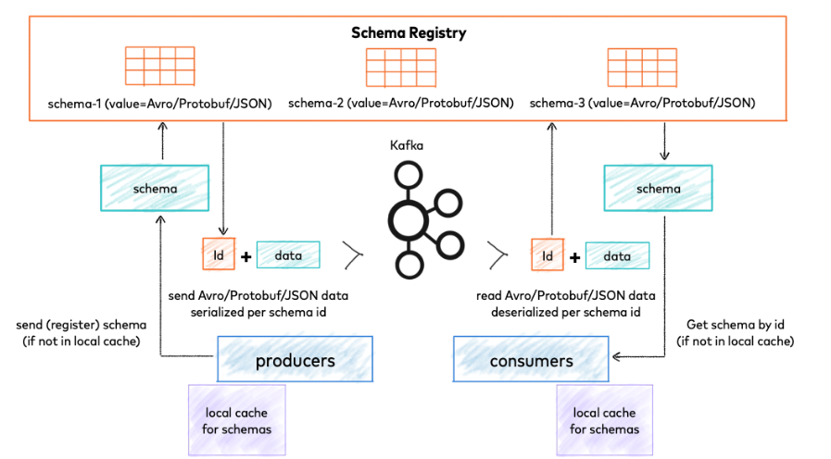
Schema Registry
Schema Registry lives outside of and separately from your Kafka brokers.
Your producers and consumers still talk to Kafka to publish and read data (messages) to topics.

Slide 79
Schema Registry (cont.)
Avro is an open-source binary data serialization format that comes from the Hadoop world.
It offers rich data structures and offers code generation on statically typed programming languages like C# and Java.
Avro has support for primitive ( int, boolean, string , float etc.) and complex ( enums, arrays, maps, unions etc.) types.
Avro schemas are defined using JSON.
It is very fast.
Avro embedded documentation prevents us from the guessing game of what each field means.
We can have a default value for fields which is very useful when we evolve our schemas.

Slide 80
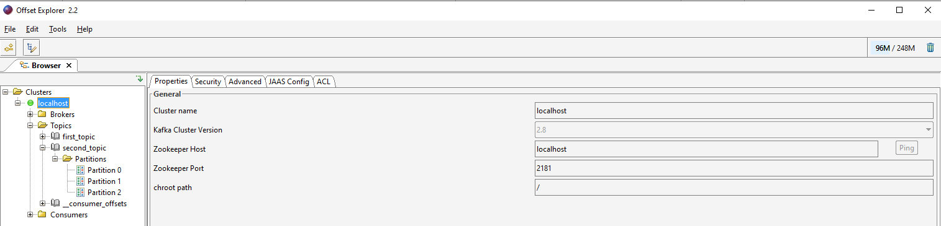
Tools
Offset Explorer 2.2 is a nice tool to query Kafka clusters.

Slide 81
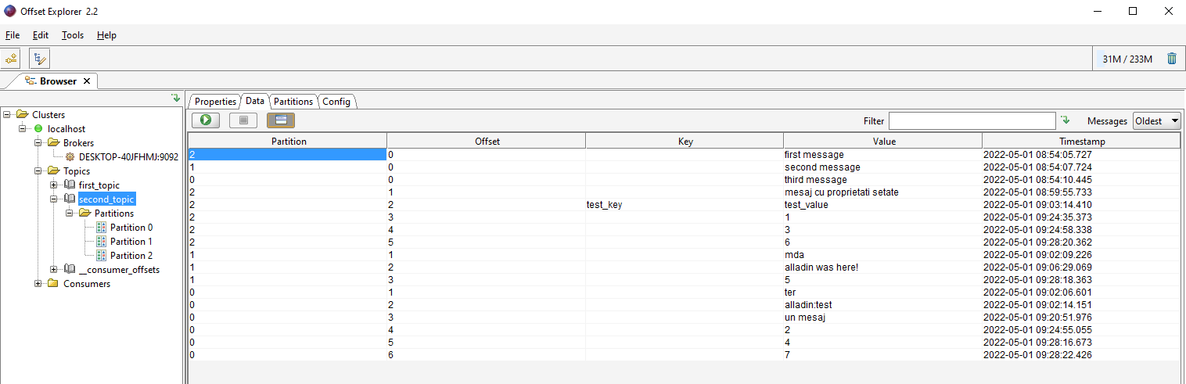
Tools (cont.)
Messages from topics can be queried.

Slide 82
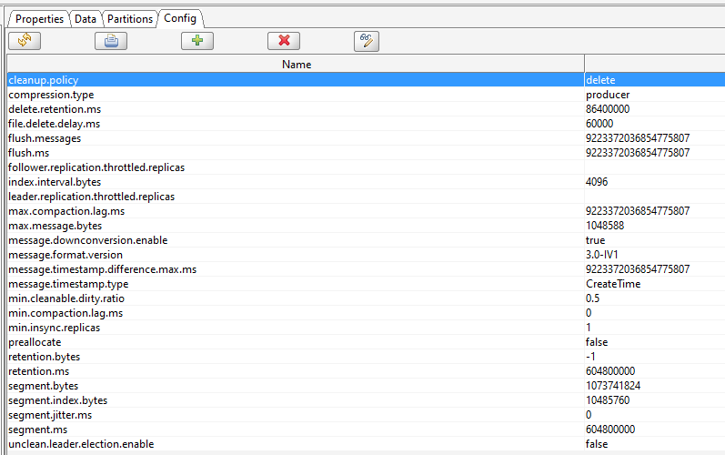
Tools (cont.)
Information about topic configuration can be seen in “Config” tab.

Slide 83
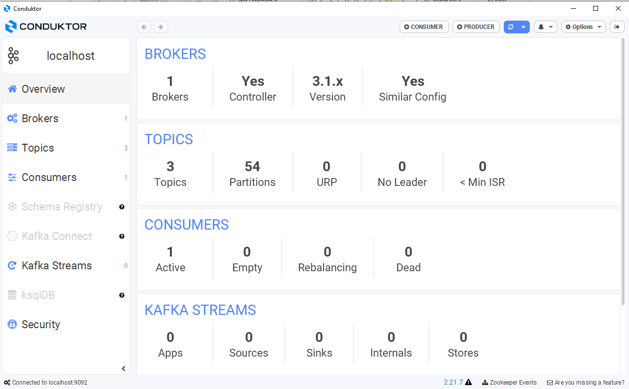
Tools (cont.)
Conduktor is a GUI for checking Kafka cluster.

Slide 84
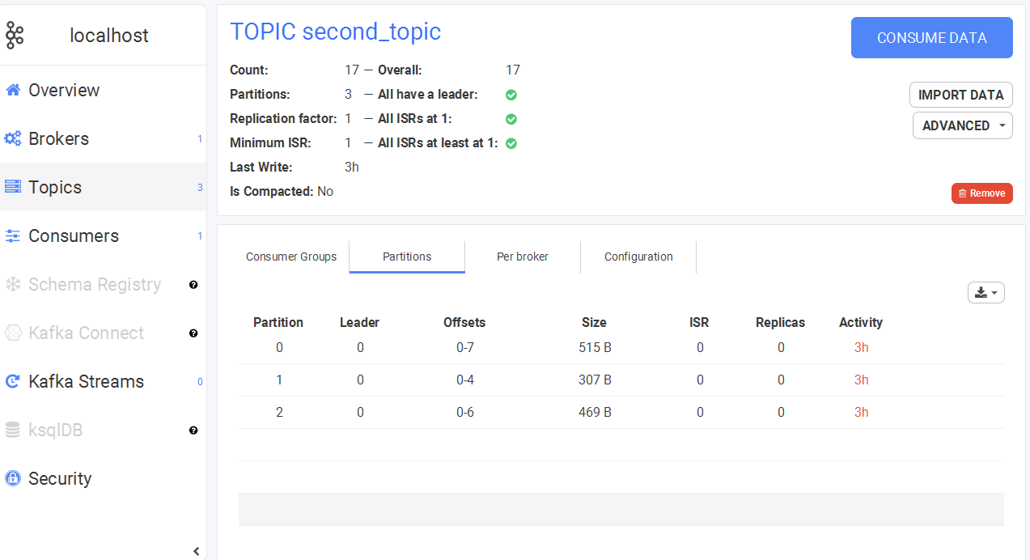
Tools (cont.)
We can check information about topics.

Slide 85
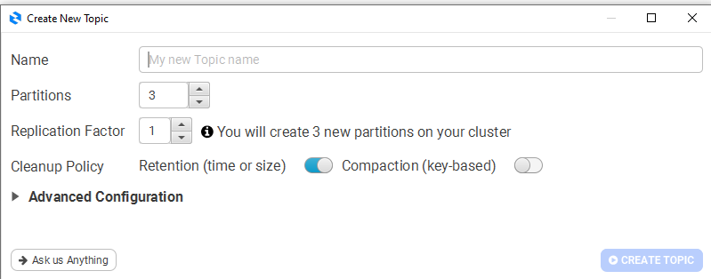
Tools (cont.)
We can create topics, consumers, producers.

Slide 86
Conclussion
PROS
Simple to setup
Uses Kafka's produce and consumer API
Replication feature
CONS:
Hard to monitor

Slide 87

Bibliography
http://kafka.apache.org
https://conduktor.io
https://en.wikipedia.org/wiki/Apache_Kafka
PacktPub - Learning Apache Kafka, 2nd Edition
Udemy – Learn Apache Kafka 3.0 Ecosystem

Slide 88
Questions ?

